Slide 1
Roman Civilization

Slide 2
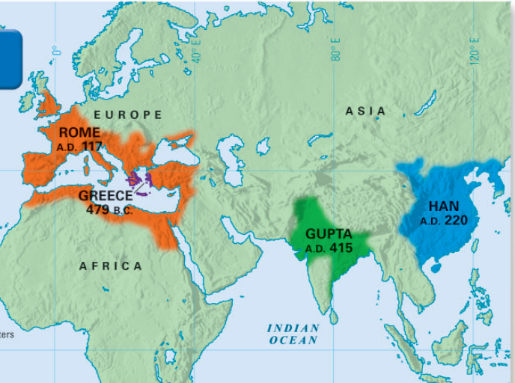
In addition to Greece, a significant classical civilization was ancient Rome
Its history from 500 B.C.- 600 A.D is known as the Classical Era.

Slide 3
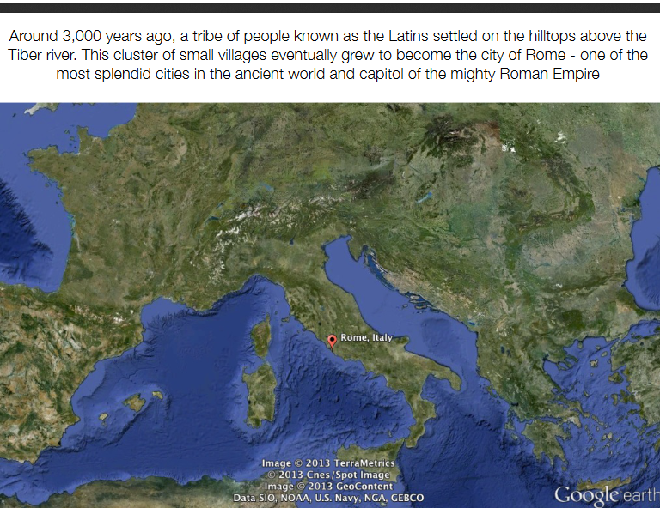

Slide 4
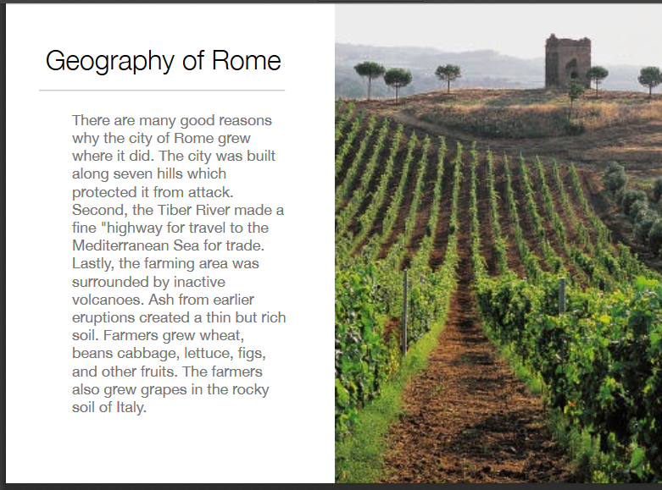

Slide 5
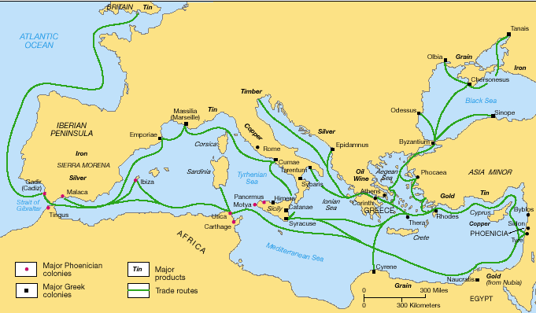
The Geography of Rome
Rome was located on the headland along the Mediterranean Sea
The Romans were influenced by the
Greeks.

Slide 6
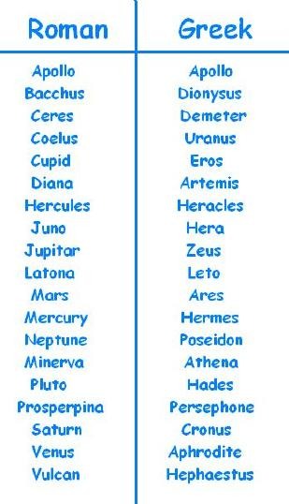
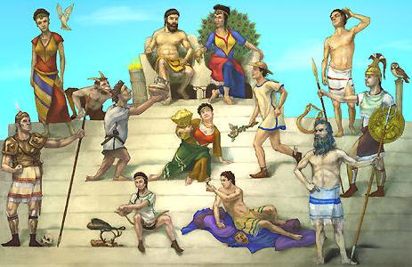
The Culture of Ancient Rome
Roman religion was polytheistic & based on the Greek gods (usually only the names changed)

Slide 7
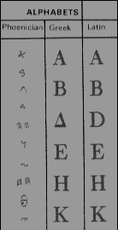
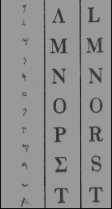
The Culture of Ancient Rome
Roman writing was called Latin & was based on Greek writing

Slide 8
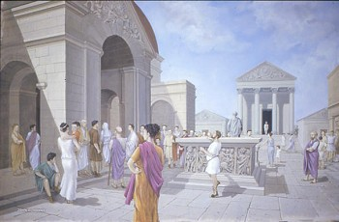
The Culture of Ancient Rome
Roman architecture borrowed heavily from Greek styles
Like Greek agoras, Roman cities had a forum for markets & public gatherings

Slide 9
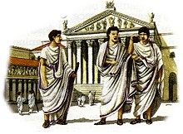
The Culture of Ancient Rome
Society was divided among 3 major groups:
At the top were the nobles, called patricians, who controlled most of the land & held key military & gov’t positions
(made up 5% of
Roman citizens).

Slide 10
The Life of the Patricians

Slide 11
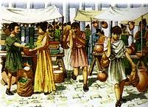
The Culture of Ancient Rome
Society was divided among 3 major groups:
Most people were commoners, called plebeians, who were farmers, shopkeepers, or peasants;
Plebeians paid
the majority of
taxes (made up
95% of Roman
citizens)

Slide 12
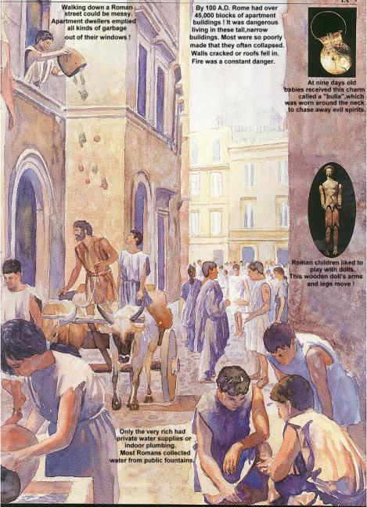
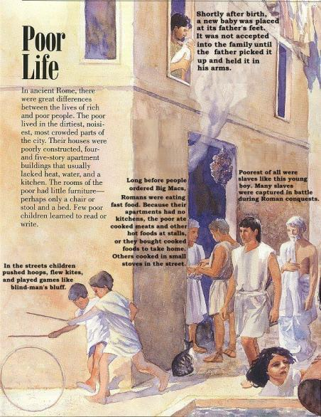
The Life of the Plebeians
Walking down a Roman street could be messy. Apartment dwellers emptied all kinds of garbage out of their window.
By 100 A.D. Rome had over 45,000 blocks of apartment buildings. It was dangerous living in these tall ,narrow buildings. Most were so poorly made that they often collapsed. Walls cracked or roofs fell in . Fire was a constant danger.
At nine days old babies received this charm called a “bulla” which was worn around the neck to chase away evil spirits
Shortly after the birth , a new baby was placed at the father feet .It was not accepted in the family until the father picked it up and held in its arms
In ancient Rome, there were great differences between the lives of rich and poor. The poor lived in the dirtiest, noisiest, most crowded parts of the city. Their houses were poorly constructed ,four and five storey apartment buildings that usually lacked heat, water, and a kitchen. The rooms of the poor had little furniture perhaps only a chair or stool and a bed. Few poor children learned to read or write.
Long before people ordered Big Macs, Roman were eating fast food. Because their apartments had no kitchen , the poor ate cooked meats and other hot foods at stalls or they bought cooked food to take home. Others cooked in small stoves in the street
Poorest of all were slaves like this young boy. Many slaves were captured in battle during Roman conquests.
Roman children like to play with dolls. This wooden dolls arms and legs move
Only the rich had private water supplies or indoor plumbing .Most Romans collected water from public fountains
In the streets children pushed hoops, Flew kites and played games like blind man’s bluff.

Slide 13
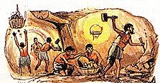
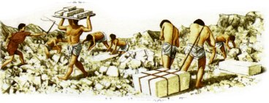
The Culture of Ancient Rome
Society was divided among 3 major groups:
At the bottom of society were slaves & other
non-Roman citizens

Slide 14
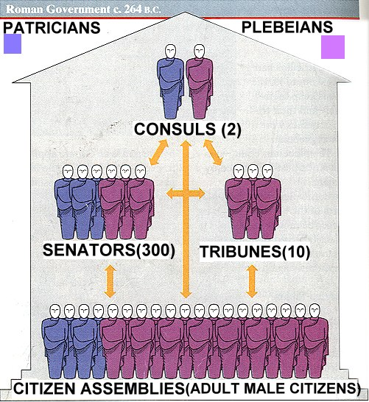
Based upon this image, what was Roman government like?

Slide 15
The Government of Ancient Rome
Rome was originally ruled by kings, but in 509 B.C. the Romans created a republic
A republic is a form
of government in which citizens have the power to elect representatives
who make laws for them.

Slide 16
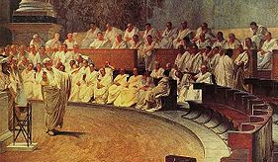
The most important feature of the republic
was the Senate, whose 300 members were elected by citizens to make laws & taxes

Slide 17
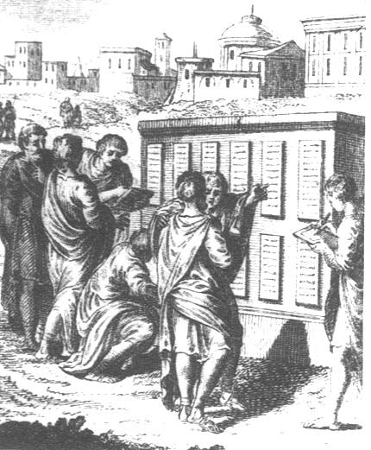
The Government of Ancient Rome
In 451 B.C., government officials wrote down Rome’s laws onto the Twelve Tables which were hung in the forum for all citizens to see
The Twelve Tables were based on the idea that all citizens had a right to the protection of the law
Notes:
17

Slide 18
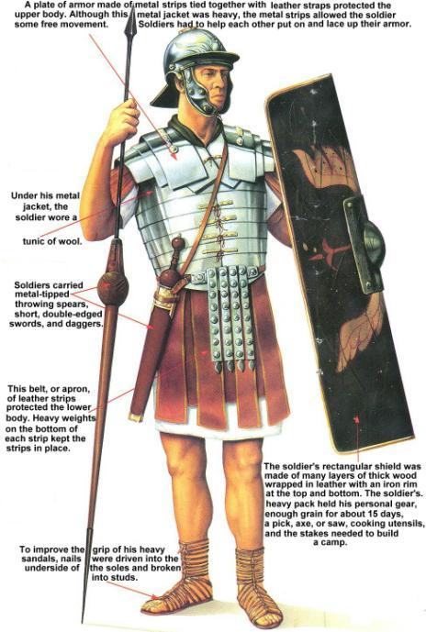
The Roman Military
Rome was protected by an advanced army that was divided into groups of 5,000 soldiers called legions
Each legion was divided into smaller groups of 80 men called a century
Notes:
The Roman Army In addition to their government, the Romans placed great
value on their military. All citizens who owned land were required to serve in the
army. Seekers of certain public offices had to perform ten years of military service.
Roman soldiers were organized into large military units called legions. The
Roman legion was made up of some 5,000 heavily armed foot soldiers (infantry).
A group of soldiers on horseback (cavalry) supported each legion. Legions were
divided into smaller groups of 80 men, each of which was called a century. The
military organization and fighting skill of the Roman army were key factors in
Rome’s rise to greatness.

Slide 19
By the 3rd century B.C., the Romans conquered the Italian peninsula & began to exert power in the Mediterranean world
But, the growth of Rome threatened Carthage, the superpower of the Mediterranean world
Expansion/growth was necessary because As Roman population continued to grow, Rome needed more land

Slide 20
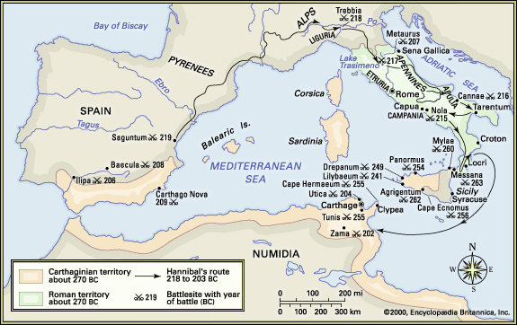
In a series of battles known as the Punic Wars,
Rome defeated Carthage & began the dominant power in the Mediterranean

Slide 21
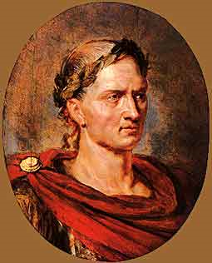
After the Punic Wars, Rome conquered new territories in Northern Europe & gained great wealth
One of the generals who led Rome’s expansion was a politician named Julius Caesar

Slide 22
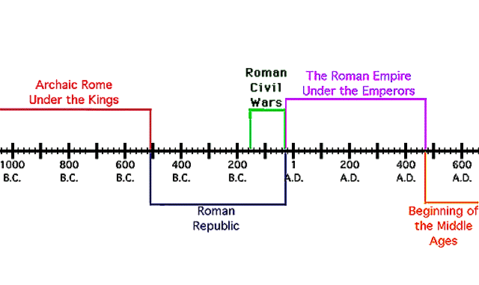
End of the Republic & Rise of the Empire
Caesar’s death changed Rome:
  People no longer trusted the Senate
  to rule Rome & the Roman Republic came to an end & the empire began

Slide 23
The Pax Romana
  Augustus’ 41 year reign marked the beginning of a 207-year era of peace, wealth, & expansion known as the Pax Romana (“the Roman Peace”) from 27 B.C. to 180 A.D.
Pax Romana

Slide 24
During the Pax Romana, the empire expanded to its height & brought great wealth to Rome
Notes:
During the Pax Romana, emperors continued to expand

Slide 25
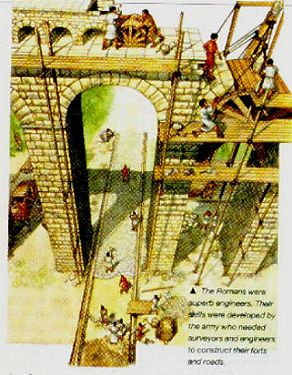
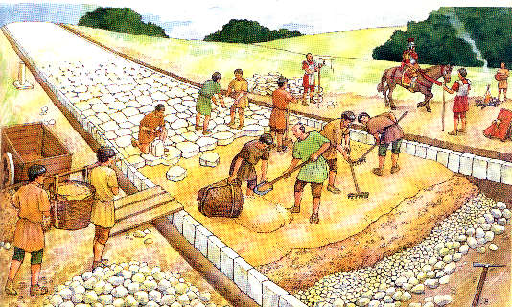
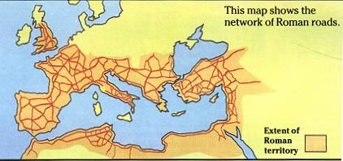
The Pax Romana became the “golden age” of Rome as emperors like Augustus built roads &
a merit-based bureaucracy to rule the empire
Roman aqueducts brought water to cities
Notes:
During the Pax Romana, emperors continued to expand

Slide 26
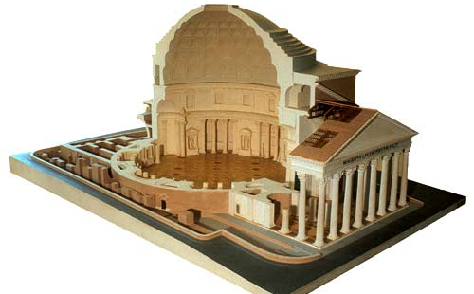
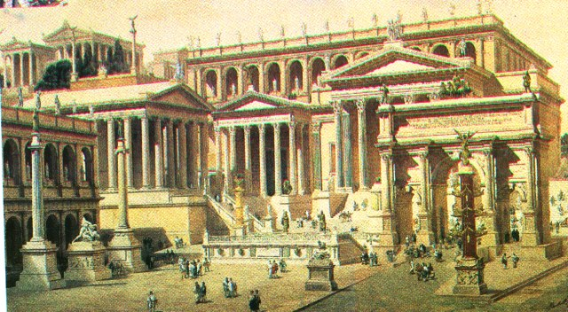
Roman architects used new styles like
domes & concrete to beautify cities

Slide 27
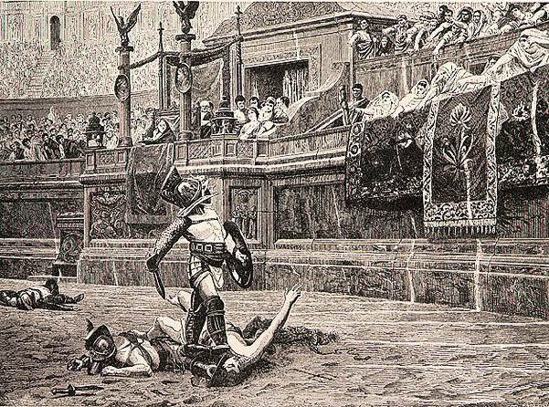
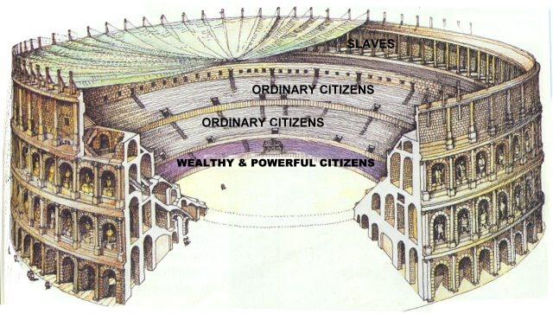
Emperors built arenas & used chariot races, gladiator events, & theater to entertain the poor
The Roman Coliseum

Slide 28
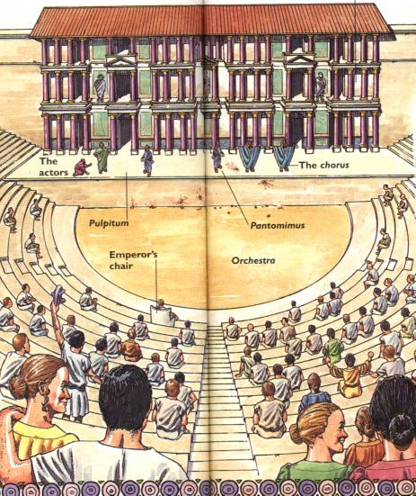

Slide 29
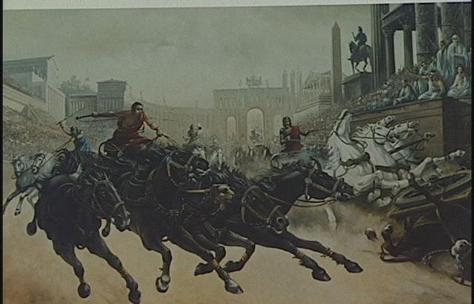

Slide 30
CITY PLANNING
Planning factors were decided long ago, beginning with Rome’s establishment near the Tiber River and Alban Hills around 753 BC.
This site offered many benefits as the river was a natural border, it flowed through the city offering water, transport, and sewage disposal, and the hills gave a safe defensive position.
The basic city plan consisted of a central forum with city services, surrounded by a compact grid of streets and wrapped in a wall for defense. The wall was also used to mark the city limits and was covered by a Portcullis, or fortified gate at the front of the city.

Slide 31
They would lay out the streets at right angles, in the form of a square grid. All roads were equal in width and length.
Each square marked by four roads was called an insula, the Roman equivalent of a modern city block. Each main road held a gateway with watchtowers.
The collapse of Roman civilization saw the end of Roman urban planning. The Ancient Roman city planning style is still very clear in Modern Rome and it has influenced many towns across Europe and the world.

Slide 32
ENVIRONMENTAL FACTORS
Roman's faced everyday problems such as air and water pollution from the sewage, which sat in the streets and the runoff from garbage. Air pollution was affected from the burning of mass amounts of wood for heat and craft workshops.
Water and air were public property to all, which allowed many regulations to be made regarding them. These public health programs were superior to most of the empires that followed until modernity.
The Roman Senate passed a law to protect water stored during dry periods so it could be released for street and sewer cleaning.
They constructed sewers to dispose of sewage and aqueducts to bring in fresh water to its parched citizens.
The first sewer was built in 500 B.C. Better sewers were built throughout the city since then.
They built hospitals and had physicians attend to the poor masses of people exposed to lead and mercury.

Slide 33
ECONOMIC FACTORS
Trade with nearby colonies was vital to the development of Rome. At the height of the Roman Empire the population of Rome was estimated to be around 1 million people.
In order to sustain the population, trade and commerce became a necessity.
The Roman Empire traded by land and by sea
Their sea routes spanned throughout the Mediterranean and the Black Sea.
Rome’s main trading partners were Spain, France, the Middle East, and North Africa
Rome imported a variety of goods such as: beef, corn, iron, leather, marble, silk, silver, spices, tin and wine.

